Slide 1

MUSIC APPLICATION
RACI Matrix
Task / Responsibility | Sudhanshu | Kunal | Pranita
Clearly defined Goal(s), Objective(s), Deliverables, and Milestones | C | A | R
Detailed Project Requirements (Business, Solution, Transition, Project, Quality, etc.) | C | R | A
Acceptance Criteria | C | A | R
Project Assumptions and Project Constraints | C | A | R
Scope Plan including Change Management Process (change control process) | A | R | C
Schedule Plan; Appropriate Diagrams and Gantt Charts | A | R | C
Project Budget and Earned Value Management analysis (planned and accumulative planned; Actual and accumulated actual costs) | A | R | C
Project Communications Plan including Stakeholder Analysis | R | C | A
Comprehensive Risk Plan including analysis, risk register including quantitative and qualitative risk assessment, risk tolerances and risk thresholds | R | A | C
Templates for Change Control, Risk Register, and others as required | R | A | C
Stakeholder definition of done in a template format | R | A | C
Keep Informed (I) | I | I | I
By-
Sudhanshu Akarshe 20000762
Kunal Bhoite 20000769
Pranita Nanekar 20000809

Slide 2
POINTS OF DISCUSSION
01
02
05
06
OVERVIEW & GOAL
OBJECTIVE
PROJECT REQUIREMENTS
03
04
ACCEPTANCE CRITERIA
SCOPE PLAN & SHEDULE PLAN
PROJECT CONSTRAINTS
08
COMMUNICATION PLAN,CHANGE PLAN,RISK PLAN
07
PROJECT BUDGET

Slide 3
OVERVIEW
In a dynamic musical landscape, our project aims to transform how we engage with our favorite tunes. Traditional music apps provide extensive libraries but fall short on community, personalization, and overall user experience.
Introducing a groundbreaking music app that merges cutting-edge technology with a human touch.
Our app tackles traditional limitations using advanced algorithms to craft a personalized music discovery engine.

Slide 4
Goal
Revolutionize music consumption
Seamless integration
Collaborative features
Real-time interactions
Offline playback
Extensive customization
Indispensable companion

Slide 5
Objective
Music Discovery Innovation
Community Building and Interaction
Improved Accessibility
Customization and Personalization
User-Friendly Design
Continuous Improvement
Testing and Quality Assurance
Licensing and Legal Compliance

Slide 6
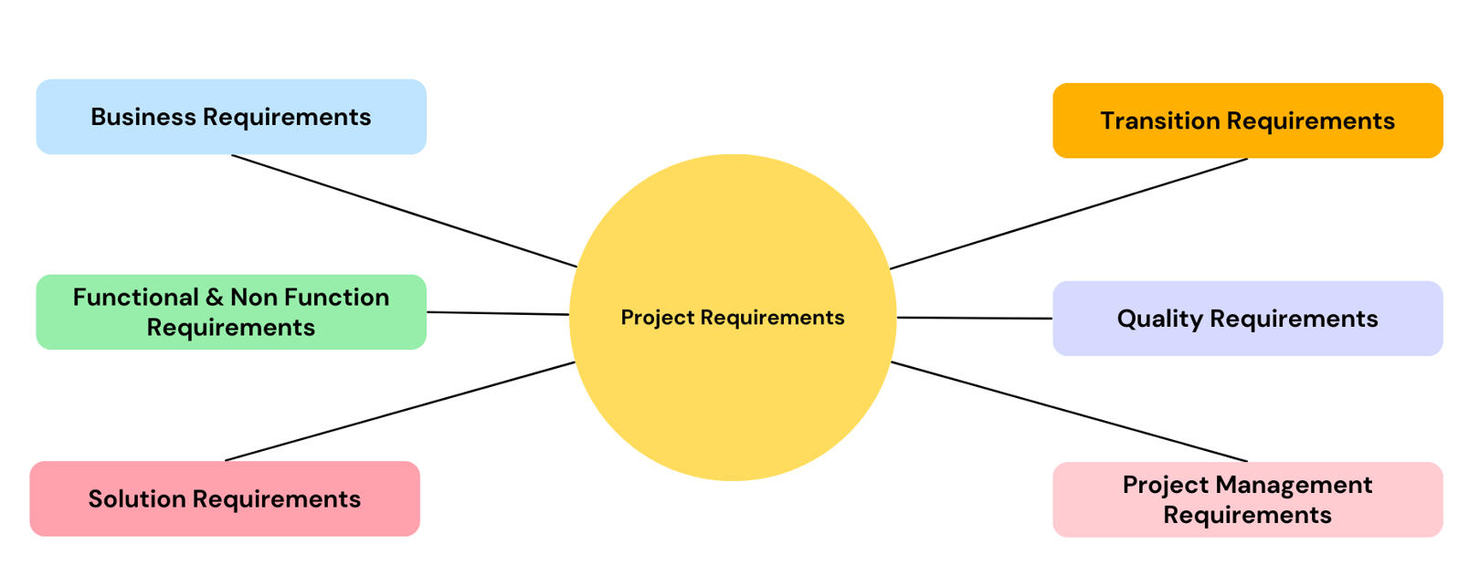
PROJECT REQUIREMENTS
Business Requirements
Functional & Non Functional Requirements
Solution Requirements
Transition Requirements
Quality Requirements
Project management requirements

Slide 7
ACCEPTANCE CRITERIA
User Registration and Authentication
Edit Personal Details
Music Streaming
Content Discovery
Playlist Management
Like/Dislike
Search Functionality
Social Integration
Premium Users-
Subscription-
Customer support

Slide 8
PROJECT CONSTRAINTS
Budget Constraints
Timeline Constraints
Resource Constraints
Scope Creep Constraints
Risk Tolerance Constraints

Slide 9
SCOPE PLAN
Scope Planning Approach
To manage the scope of the Music App effectively, an Agile scope planning approach will be employed. This involves breaking down the project into smaller, more manageable increments called sprints. Each sprint focuses on a specific set of tasks, enabling the team to deliver working software incrementally and gather feedback from stakeholders throughout the development process.
A key aspect of agile scope management is the establishment of a clear and transparent backlog. This backlog serves as a prioritized list of tasks and features that need to be addressed in each sprint.

Slide 10
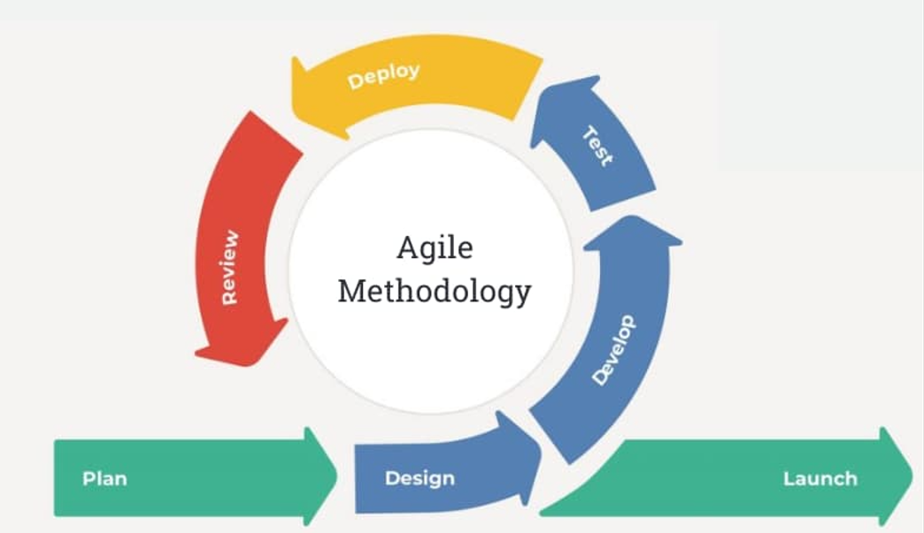
Azure DevOps Integration
Integrating Azure DevOps into the Music App project will provide a centralized platform for managing the project's lifecycle and enhancing collaboration among team members.
This integration will also improve productivity, ensure efficient project delivery, and reduce the risk of errors.

Slide 11
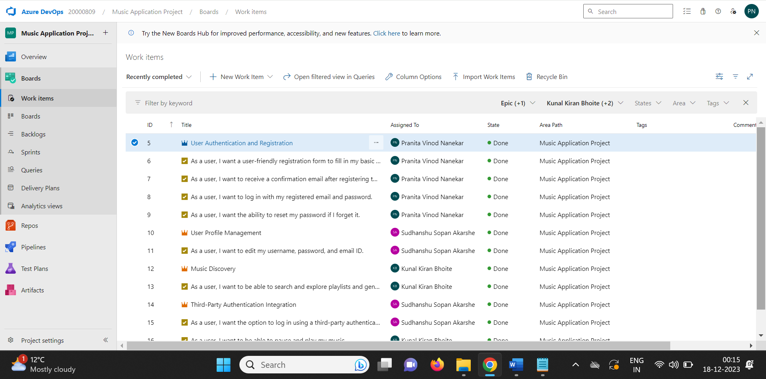
ASSIGNMENT ON USER STORIES

Slide 12
ASSIGNMENT ON USER STORIES
Developer Responsibilities
Designer Responsibilities
QA Engineer Duties
Integration Specialist Responsibilities

Slide 13
CHANGE MANAGEMENT PROCESS
Activity | Description | Responsible
Submit Change Request | The change request should be submitted in writing and include the following information: a description of the proposed change, the justification for the change, the impact of the change on the project scope, schedule, and budget, and the proposed mitigation strategies for any negative impacts. | Change Requestor
Review Change Request | The change request will be reviewed by the project manager and stakeholders. | Project Manager, Stakeholders
Approve/Reject Change Request | The project manager and stakeholders will determine whether to approve or reject the change request. | Project Manager, Stakeholders
Estimate Testing Effort | The project manager will estimate the testing effort required for the approved change. | Project Manager
Schedule Testing | The project manager will schedule the testing for the approved change. | Project Manager
Conduct Testing | The approved change will be tested by the testing team. | Testing Team
Analyze Test Results | The testing team will analyze the test results and provide feedback to the project manager. | Testing Team
Update Project Scope, Schedule, and Budget | If the testing results indicate that the change requires additional development or testing, the project scope, schedule, and budget will be updated accordingly. | Project Manager
Implement Approved Change | The approved change will be implemented by the developers. | Developers
Monitor and Update Change Log | The change log will be updated to reflect the approved change and any associated testing activities. | Project Manager
Communicate Change to Stakeholders | The change request, approval/rejection decision, and updated project scope, schedule, and budget will be communicated to all stakeholders. | Project Manager

Slide 14
ROLES AND RESPONSIBILITIES
Project Manager: Responsible for managing the change request process.
Stakeholders: Responsible for reviewing and approving change requests.
Developers: Responsible for implementing approved changes.

Slide 15
SCHEDULE PLAN
Project kickoff(Week 1)
Requirement Gathering & Planning (Week 1-2)
Development & Testing (Week 3-23)
Implementation (Week 24-25)
Deplyoment(Week 26-28)

Slide 16
PROJECT BUDGET
Project resources | Value | Cost ($/Annual)
Development team | 5 developers 2 UI/UX designer 2 QA engineers 1 Project manager | 80,000 per developer and 100,000 project manager.
Marketing and support | 2 members | 100,000
Tools and license | IDE, React, MongoDB, OpenAPI, Jira, Adobe XD, Jenkins, Selemium | 50,000
Infrastructure | Cloud hosting cost | 20,000
 | Total Estimated cost: | 990,000

Slide 17
COMMUNICATION PLAN
Objectives
Stakeholder Analysis
Communication Channels
Communication Methods
Frequency and Timing
Escalation Procedures
Review and Update

Slide 18
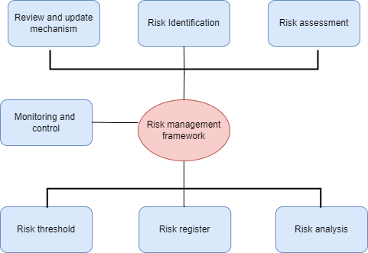
RISK PLAN
Risk Identification
Risk Analysis
Risk Register
Risk Tolerances and Risk Thresholds
Monitoring and Control
Review and Update Mechanism

Slide 19
RISK PLAN
Risk Type | Risk ID | Description | Probability | Impact | Mitigation
 | (Unique ID) | (Summary of risk) | Rate 1(LOW) to 5(HIGH) | Rate 1(LOW) to 5(HIGH) | (Measures to lower or eliminate risk)
Technical | 1001 | Incompatibility with certain operating systems | 4 | 5 | Perform complete testing and compatibility test during development phase
Market | 1002 | Changing UI as per user preferences for music | 5 | 2 | Keep close note of customers feedback and market trends
Resource | 1003 | Executive/ senior technical person leaving the project | 1 | 5 | Cross train team members and maintain documentation if development work
Regulatory | 1004 | Changes in law of customer data gathering | 4 | 5 | Regularly review data protection laws
Integration | 1005 | Application facing issue for third party API integration | 2 | 2 | Establish strong partnership and develop reliable application
Security | 1006 | Security breach | 1 | 5 | Review and update security system on regular intervals

Slide 20
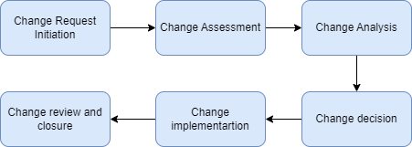
CHANGE CONTROL
Change request initiation
Change assessment
Change analysis
Change decision
Change implementation
Change Review and closure

Slide 21
STAKEHOLDER ANALYSIS
Stakeholder Involvement:
Functional requirements:
Non-functional requirements:
Documentation:
Testing and Validation:
Deployment and release:

Slide 22


THANK YOU

